Slide 1
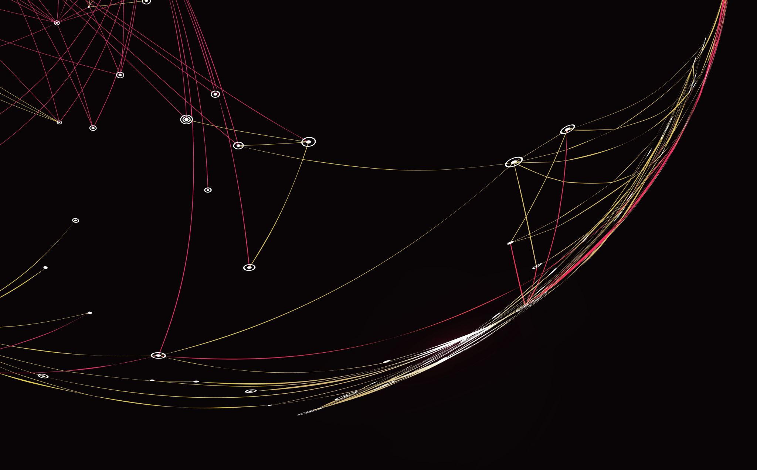
University Class Manager
By: Nilmo Contreras

Slide 2
About Me
My name is Nilmo Contreras
I currently attend New Jersey Institute of Technology
I am a double major in CS and IT
I have prior experience with Java and Python

Slide 3

What I have learned from this course
.NET Core platform
Setup
Commands
Projects
C#
OOPS
LINQ
SQL Server
Data Query
Data Structure
Data Operations
Entity Framework

Slide 4

My Project
I decided to create a university schedule manager
I felt that it would be the best way to use all the skills I have learned
This project also helped me to better understand what I knew in theory vs what I knew in practice

Slide 5
Database Schema
Student Info
Student Id
Student Name
Username
Email
Phone Number
Password
Teacher Info
Teacher Id
Class Info
Class Id
Class Name
Department
Class Building
Classroom
Teacher Id
Student Schedule
Student Id
Class Id
Name
Email
Phone Number

Slide 6
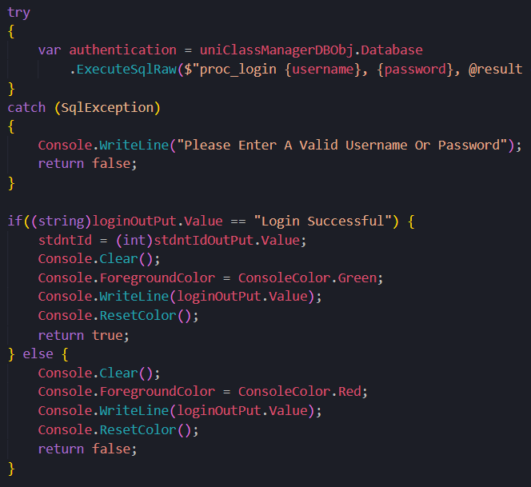
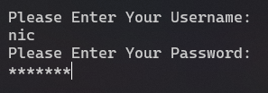
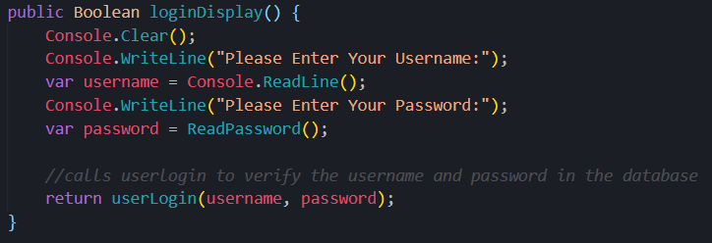
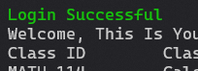

Entity Framework Core
ORM
Student Info
Student Id
Student Name
Username
Email
Phone Number
Password

Slide 7
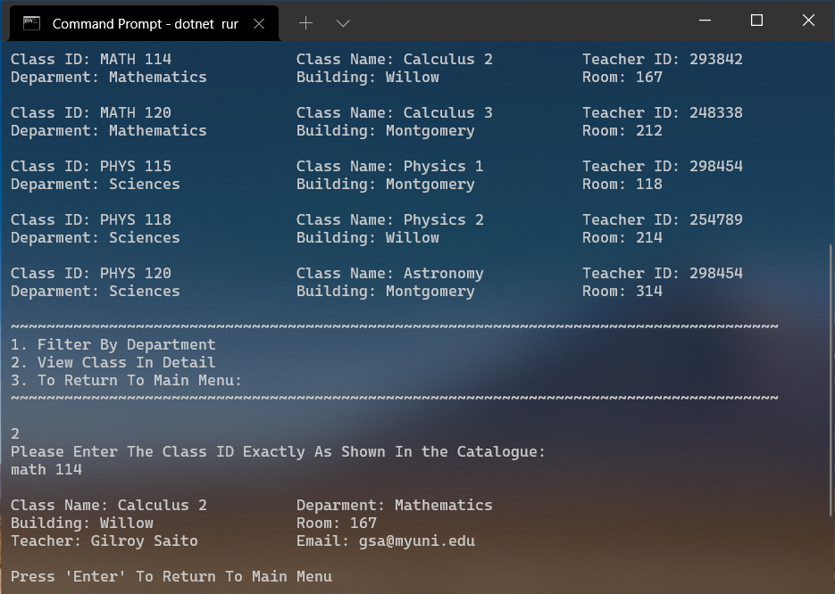
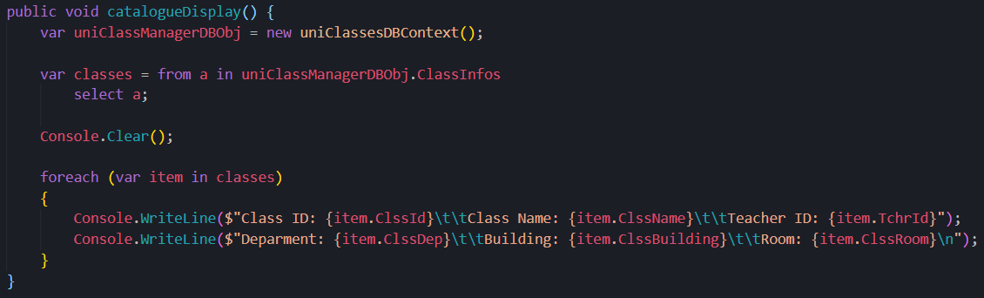
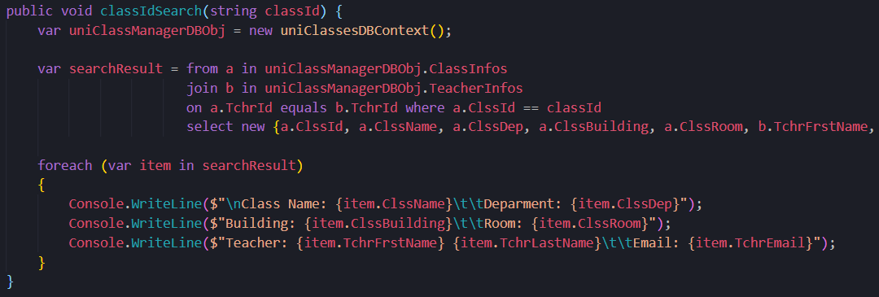
In Theory Vs In Practice

Slide 8
Features To Be Added
Admin Account
Add Class to Catalogue
Remove Class from Catalogue
Update Class info
Add/Remove Teachers
Teacher Account
View Students in Class
Update their info
Counselor Account
Add class to student schedule
Remove class from student schedule

Slide 9
Project Demonstration
And Q&A

